Slide 1

Clarity-to-Jira Ticket Automation
Streamlining your project management workflow from request to execution

Slide 2
The Challenge We Solved
Before Automation
After Automation
Manual ticket creation across multiple platforms
Seamless integration across systems
Time-consuming data entry and duplication
Instant ticket creation in Jira
Risk of human error and information loss
Consistent data accuracy
Delayed project kickoff times
Faster project initiation

Slide 3




How It Works: High-Level Overview
Clarity
User creates and submits a request through the Clarity application interface
Wrike
Request automatically triggers Wrike project creation via integration
Jira
Webhook listens and creates corresponding Jira tickets instantly

Slide 4

Step 1: Request Initiation in Clarity
Users begin by accessing the Clarity application and filling out a request form with all necessary project details, requirements, and specifications.
Once complete, they click the "Create Request" button, which initiates the entire automated workflow.
This single action eliminates the need for manual data entry across multiple platforms, saving valuable time and reducing errors.

Slide 5
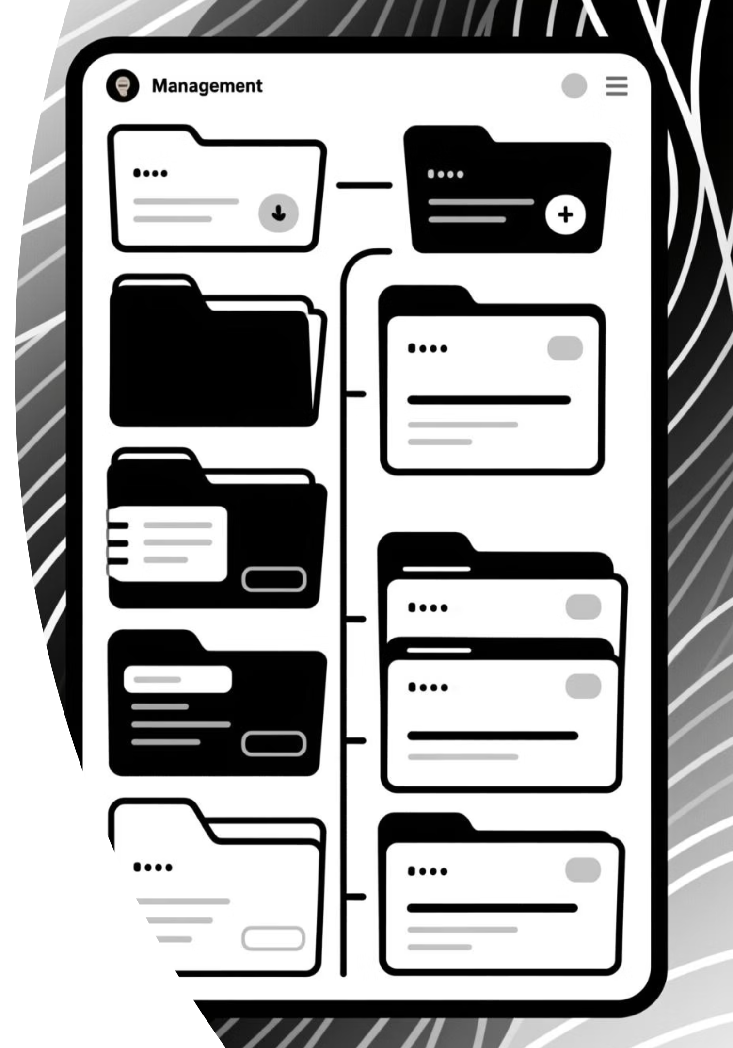
Step 2: Wrike Project Creation
Automatic Trigger
Data Mapping
The Clarity request automatically creates a new project in Wrike with all relevant information populated from the original request.
Request fields are intelligently mapped to Wrike project attributes, ensuring all critical details are preserved and properly organized.
Webhook Activation
The moment the Wrike project is created, it triggers a webhook event that our system is actively listening for.

Slide 6
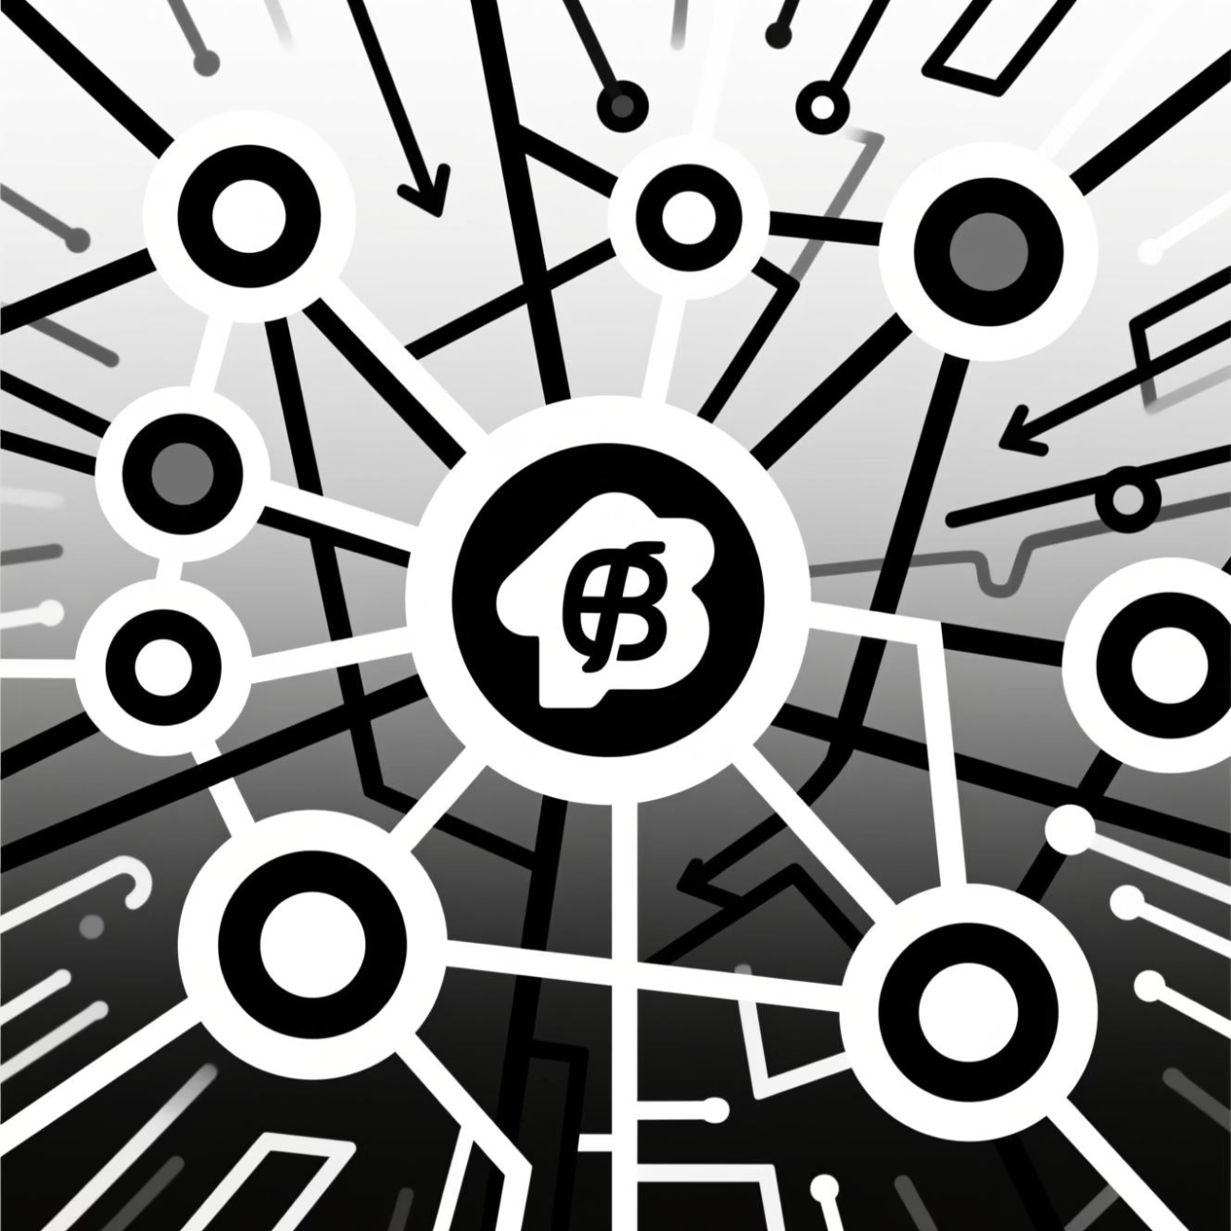
Step 3: Webhook Event Monitoring
Real-Time Event Detection
Our system uses Wrike webhooks to monitor all project activities in real-time. This ensures we capture project creation events the instant they occur.
The webhook acts as a bridge, sending immediate notifications about new Wrike projects to our automation engine, maintaining seamless connectivity throughout the workflow.

Slide 7
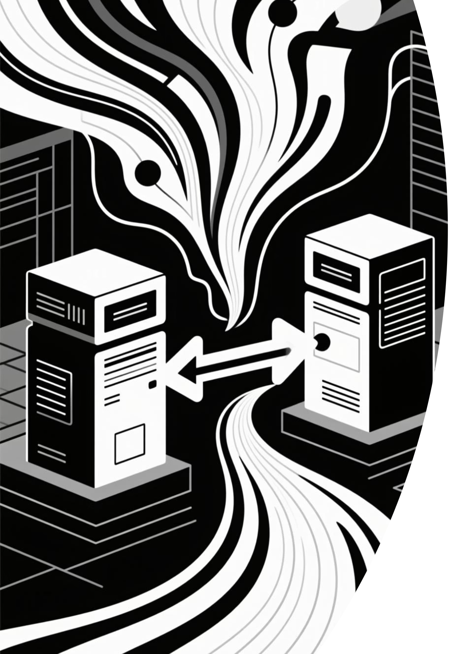
Step 4: Jira Ticket Creation
01
Event Reception
System receives the webhook notification from Wrike about the new project
02
Data Processing
Extracts and transforms project information into Jira-compatible format
03
API Call
Uses Jira REST API to create tickets with mapped fields and attributes
04
Confirmation
System confirms successful ticket creation and logs the transaction

Slide 8




Technical Architecture
Clarity Application
Wrike Webhooks
Jira REST API
Role: Frontend interface
Role: Event listener
Role: Backend integration
Function: Request submission and user interaction
Function: Real-time project creation monitoring
Function: Automated ticket generation

Slide 9
Key Benefits
Speed & Efficiency
Data Accuracy
Reduces ticket creation time from minutes to seconds, allowing teams to focus on actual work rather than administrative tasks.
Eliminates manual data entry errors by automatically transferring information between systems with perfect consistency.
Seamless Integration
Full Transparency
Creates a unified workflow across three platforms, ensuring all teams have synchronized information at all times.
Provides complete visibility into the entire request-to-ticket journey with automatic logging and tracking.

Slide 10

Ready to Transform Your Workflow
What's Next?
We're ready to deploy this automation tool and help your team experience the benefits of streamlined project management.
Questions?
Let's discuss how this solution fits into your specific workflow and any customizations you might need.

